Slide 1
South Carolina Department of Motor Vehicles
Basic Title and Registration Requirements for
Automobile Dealerships
2023

Slide 2
Purpose
The purpose of this training is to educate dealers on the proper title and registration procedures and to provide points of contact to assist them

Slide 3
Standard Paperwork Required
SC Credential or Other Identification Requirements
Manufacturers Certificate of Origin (MCO) or Current Title with Reassignments
Bills of Sale (BOS)
Certified Odometer Statement
Dealer’s Retail Sales Tax Identification Number
Infrastructure Maintenance Fee (IMF)
Gross Vehicle Weight (GVW)
Affidavit & Notification of Sale of Motor Vehicle (Property Tax Override: PTO) (If purchasing a plate) – SC Licensed Dealers Only
Liability Insurance Information (If purchasing or transferring a plate)
License Plate Number (if transferring a plate)
Title Application Form 400

Slide 4
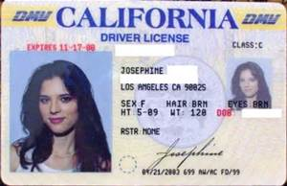
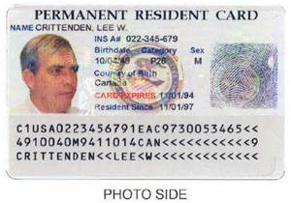
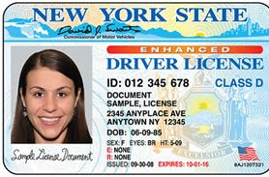
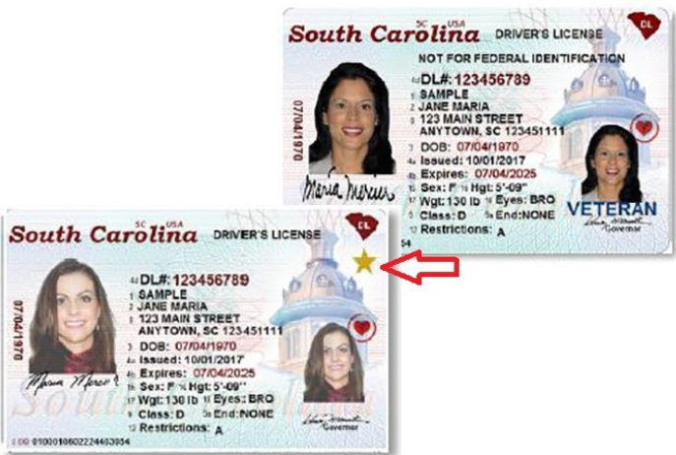
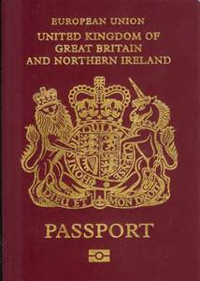
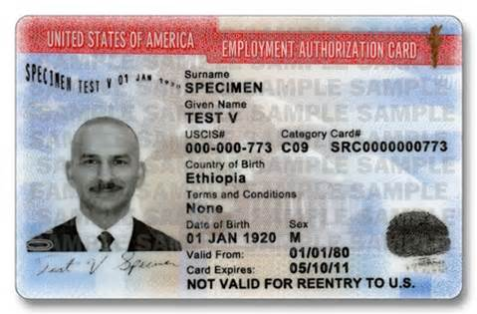
Identification Requirements

Slide 5
3 Important Points
Individuals who hold a South Carolina credential will not need to provide any additional identification requirements to title and register a vehicle.
Obtain positive ID from ALL owners to verify names.
For Business customers you must provide:
Business Name
Address
Federal Employer Identification Number (FEIN)

Slide 6
ID Requirements for Individuals
When titling and/or registering a vehicle, each individual should present a valid South Carolina credential (DL, BP, or ID)
If the individual does not have an SC credential, the individual must present one of the following:
Out-of-State credential
Passport
Employment Authorization Document(EAD)
Permanent Resident Card

Slide 7
Form TI-006: Statement of Vehicle Operation in South Carolina
Provide a clear copy of the individual’s identification documentation
Indicate Operation Status
Active-Duty Military Service
School Enrollment
Vehicle Principally Garaged in South Carolina
Medical or Physical Impairment
Current proof of the individual’s SC address
Refer to the MV-93 for a list of acceptable proof of address
Some customers may complete the TI-006A – Affidavit of Vehicle Principally Garaged at South Carolina Residence as proof of address
Page 2 of the form provides any additional information on proper completion of the form

Slide 8
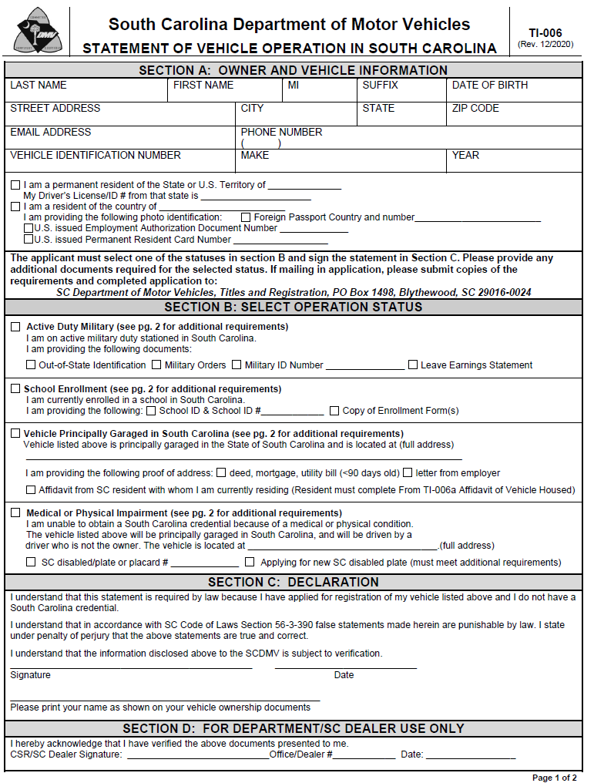

Slide 9
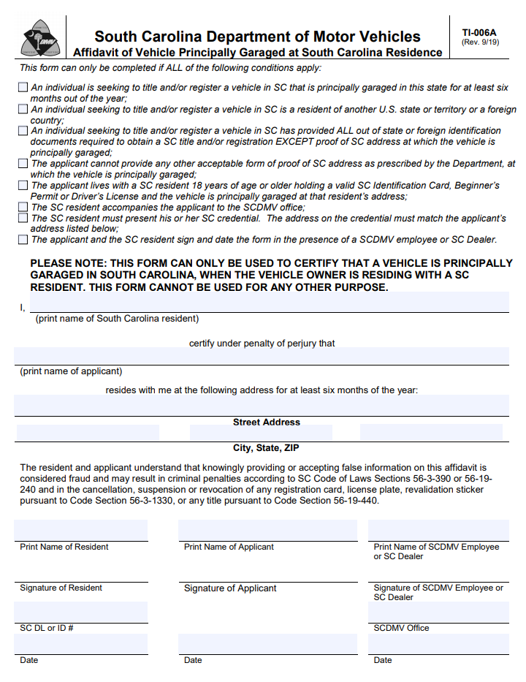

Slide 10
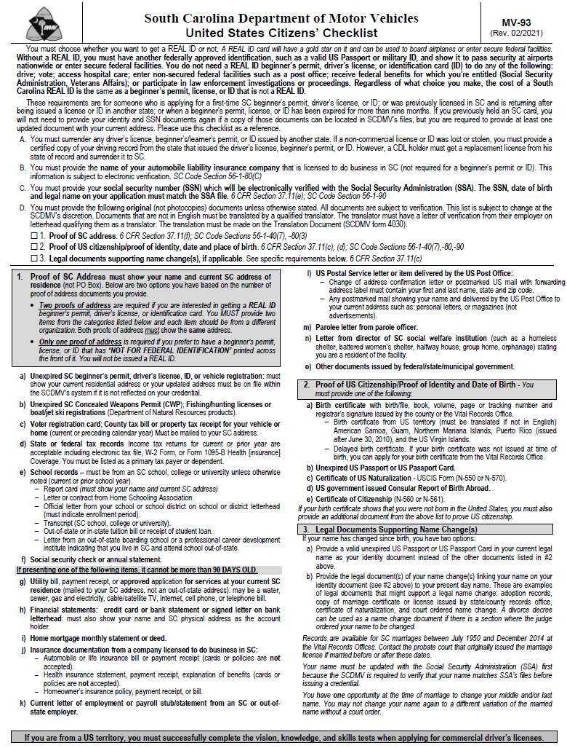

Slide 11
Requirements for Individuals
For vehicles with more than one owner, only one co-owner must comply with the address requirements
Example: John and Trish buy a car and they both have Out of State licenses (We only need the TI-006 for one of them)
Legible copies of the credential or passport are acceptable
Individuals must comply with these requirements each time a vehicle is newly titled or registered in their name

Slide 12
Requirements for Business Customers
For vehicles titled and/or registered in a business name, the following must be provided:
FEIN or SSN
Must indicate a bona fide place of operation in South Carolina
For businesses located out of state, either the SC address of the driver or an SC housed address for the vehicle must be indicated
If the vehicle is being leased, the lessee, who is the registrant, must comply with address requirements

Slide 13
Title Requirements

Slide 14
MCO or Current Title
MCO must either be assigned to the dealer on the front or include the proper chain of transfers from dealer to dealer
This can be done using the assignments on the MCO/Title, Title Assignment Forms, or Bills of Sale
Make sure to verify the VIN from MCO/Title with the vehicle being sold
Use Form 5047: Power of Attorney for Odometer Disclosure if the trade-in vehicle’s title is with a lien holder or lost

Slide 15
5047 – POA for Odometer Disclosure
This is a Limited Power of Attorney which will grant a dealer the ability to sign only the title on behalf of the customer and nothing else
Should only be used when:
The owner’s title has been lost or
The owner’s lien holder is holding the title
The purpose of this document is for the dealer to receive the odometer disclosure from the customer until the title is obtained
*Note: To be able to sign any other document on behalf of the customer you must have a non-secured power of attorney!

Slide 16
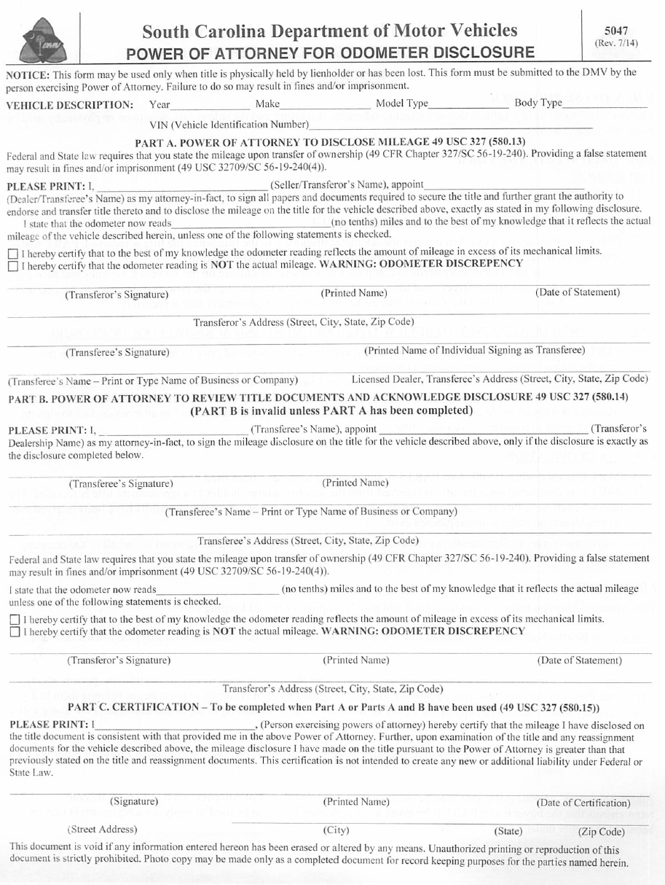

Slide 17
When To Use a 5047
TRANSACTION | Should Secured Power of Attorney (5047) be Used?
Title is being held by lien holder or security interest at the time of transfer | YES, to disclose the odometer when the title is obtained.
Title (without lien) is lost, stolen or destroyed and a duplicate title is required to complete the transfer of ownership | YES, to disclose the odometer when the title is obtained; but, not to sign Form 400 to obtain the duplicate title.
Title (without lien) is lost and there will be no transfer of ownership | NO
Transaction does not involve transfer of ownership | NO
Transaction does not require odometer disclosure | NO

Slide 18
Non-Secured Power of Attorney Rules
There is no standard format, but the document must include:
Individuals Name
Attorney-In-Fact
Vehicle Description
VIN, Year, Make, and Model
Individuals signature
Witness Signature
Attorney-In-Fact does not need to sign
Copies are Acceptable

Slide 19
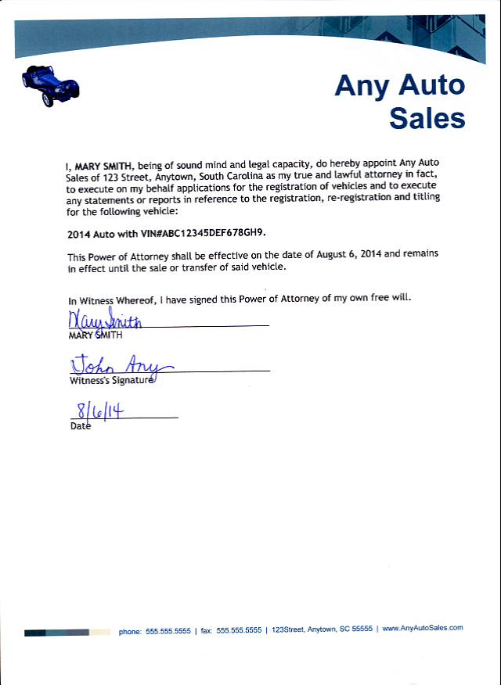
Sample POA

Slide 20
Title Reassignments
Required for each transfer of ownership
The first assignment on an MCO/Title must be completed
Title Reassignment Forms or Bills of Sale are acceptable once the first assignment is completed
MCO/Title may have several spaces for reassignments from dealer to dealer
Can be assigned from dealer to dealer without titling but must be titled once assigned to a customer

Slide 21
Affidavit & Notification of Sale of Motor Vehicle
Only Licensed SC Dealers may use this form
Make sure all information transfers through clearly to all copies
If purchasing a plate advise the customer on Property Tax Deferment of 120 days
Explain the difference between the Infrastructure Maintenance Fee and Property Taxes
Can not be used as a Bill of Sale for the final transfer of ownership
This form is commonly referred to as a Property Tax Override (PTO)

Slide 22
Errors on Title Reassignments
The seller, from the assignment which included the error, must complete a TEA-1: Title Reassignment Error Acknowledgement Form
Must provide either a secured bill of sale with the correct assignment information or complete the next reassignment on the title with the correct reassignment information (if the sales price is listed)
Mark an “X” through the incorrect assignment on the back of the title/MCO
If an individual changes their mind about the purchase, a statement from the individual must be submitted along with the TEA-1. This statement must state that they did not take possession of the vehicle and include the vehicle description (VIN, Year, Make, and Model)

Slide 23
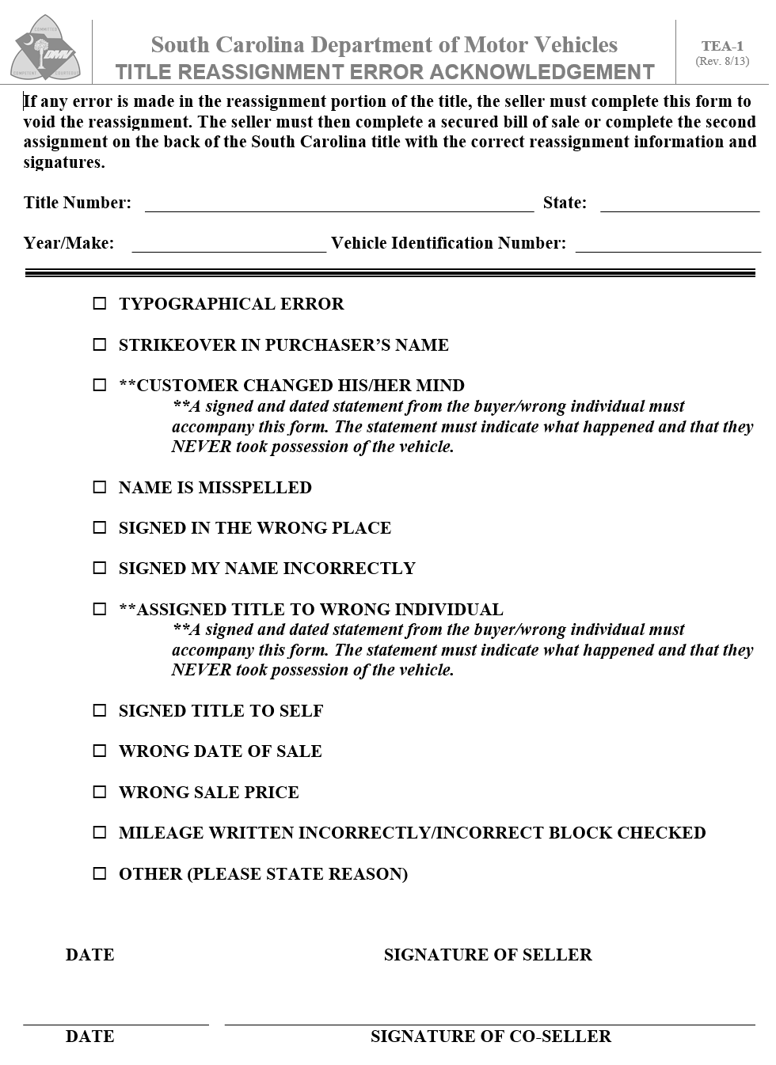

Slide 24
Odometer Disclosure Requirements

Slide 25
Odometer Statement
Per the Truth in Mileage Act enacted in 1989, an odometer disclosure is required at the time of sale or transfer
The odometer must be disclosed for each transfer of ownership which includes dealer to dealer
The odometer can never decrease.
If the previous title did not indicate mileage, the new SC title must be listed as either “Exempt” or “Not Actual”

Slide 26
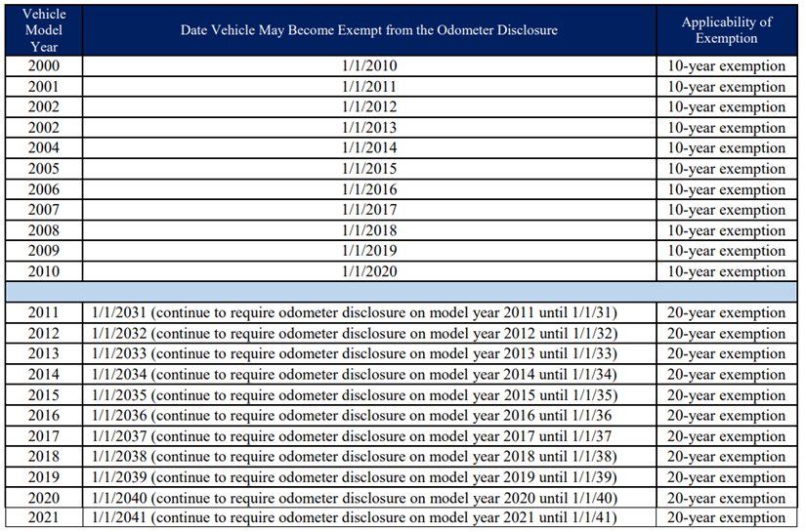
Odometer Statements
Odometer Exemption
Vehicles 20 years old or older (depending on model year)
Vehicles with GVWR of over 16,000 lbs.
Vehicles that are not self-propelled
Low-speed vehicles without an odometer
Other odometer brands include
Exceeds Mechanical Limits
Not Actual Mileage
Click here to learn more

Slide 27
Common Odometer Issues
Strikethroughs in the odometer reading on an assignment
No odometer reading listed on the PTO
No odometer reading listed on the reassignment

Slide 28
Odometer Corrections
Odometer corrections must be sent to DMV Headquarters and must include the following:
TI-008: Odometer Correction
Service Records or other documentation supporting the correction – not less than 2 within the preceding 12 months
Title Fees
*Request must be made by mail to SCDMV Headquarters*

Slide 29
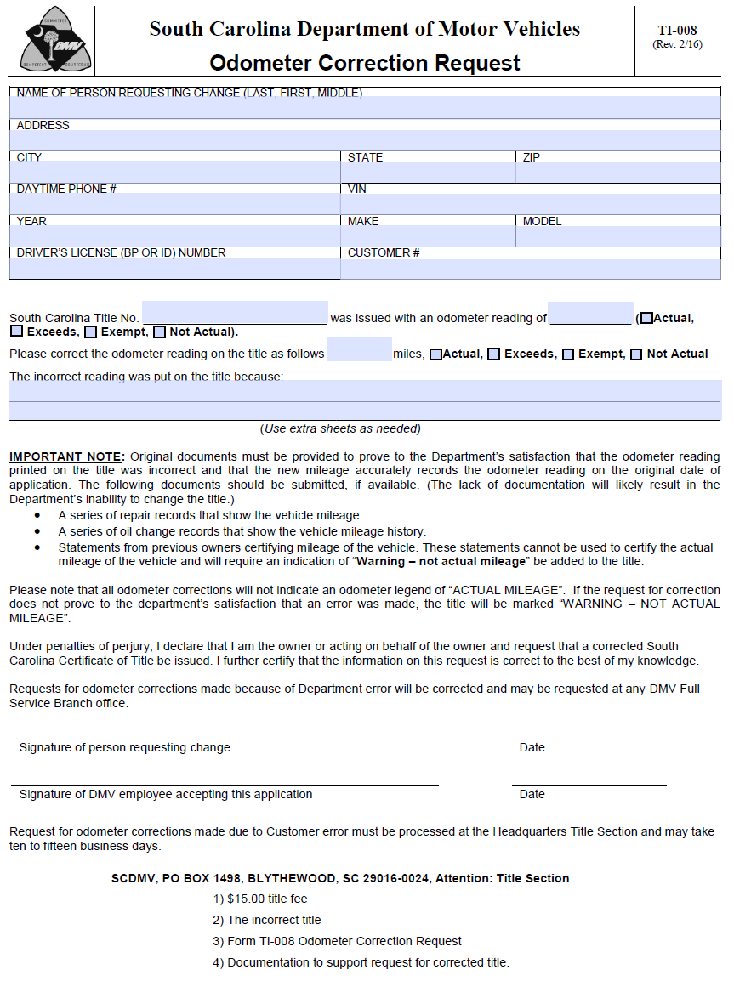

Slide 30
Infrastructure Maintenance Fee

Slide 31
Collection of IMF Fees
5% Infrastructure Maintenance Fee (IMF) (up to $500) is due when a vehicle is sold to a customer and must be paid to the DMV when the vehicle is titled and/or registered.
Out of State Sales (selling a vehicle to a customer who lives out of state) Require the following:
A buyer's order and the Form ST-385
Affidavit of Intent to License Motor Vehicle... Purchased in South Carolina in the Purchaser’s State of Residence
Maintain a copy in the dealer’s records to support any deduction taken on the sales tax return
Give a copy to the customer to submit to their local tax authorities
Contact SCDOR at (803) 898-5000 for additional information on tax deductions
Enter the retail sales tax number on the title application along with the vehicle sales price(including doc fees), trade in amount, and tax credit (if applicable).
ALL DEALERS MUST COLLECT IMF; IT IS NOT OPTIONAL!

Slide 32
Common IMF Exemptions
Sales of motor vehicles or motorcycles to nonresident military personnel:
Military personnel possessing an SC credential are not disqualified from this exemption
The customer must furnish a leave and earnings statement (LES) from the appropriate department of the armed services that indicates his declared state of residence is a state other than SC
This exemption only applies to motor vehicles primarily designed to carry passengers (e.g., cars, passenger vans, trucks that have an empty weight of 9000 lbs. or less and a gross weight of 11,000 lbs. or less, and sport utility vehicles)
It does not include motor vehicles designed primarily to carry property such as trucks (with an empty weight of greater than 9000 lbs. and a gross weight of greater than 11,000 lbs.) or cargo vans. IMF is due on sales of property-carrying vehicles

Slide 33
Common IMF Exemptions
Sales of motor vehicles or motorcycles by or to the federal government
Sales of motor vehicles or motorcycles by or to federal credit unions
Sales of motor vehicles to charitable hospitals, predominately serving children where care is provided without charge to the patient

Slide 34
License Plates

Slide 35
Title and Registration Fees
Title Fee | $15.00
Infrastructure Maintenance Fee | 5% of the purchase price (Maximum $500)
Basic Registration/Plate Fee | $40.00 or GVW rate (see chart)
Plate Transfer Fee | $10.00
Expedite Fee (for over-the-counter requests) | $20.00
Specialty License Plate Fee | Varies depending on plate type
Alternative Fuel Road Use Fee | $120.00
Hybrid Road Use Fee | $60.00

Slide 36
Minimum GVW
Required for all trucks and cargo vans
Calculated as the empty weight of the vehicle plus the heaviest load carried
Must be declared by the registered owner
Can not be lower than the empty weight
Determined in Units of 1,000 lbs.
For example, Empty Weight = 4,348, min. GVW = 5,000
Empty Weight = 5,892, min. GVW = 6,000

Slide 37
Liability Insurance Information
The name of the automobile insurance company, not the name of the agent, must be furnished on the Title Application (Form 400) if purchasing or transferring a plate.
The liability insurance company must be licensed to do business in South Carolina.

Slide 38
License Plate Transfers
Plate type must stay the same
At least one previous owner on the plate must match the new listed owners
Individuals may place the plate they are transferring on the new vehicle at the time of purchase
Plates may be transferred from a car to a truck if the empty weight of the truck is less than 9,000 lbs. and/or gross weight is less than 11,000 lbs.
More than 3 months must be left on the plate to be able to transfer
The fee to transfer a license plate is $10.00 + any fees for additional weight (if applicable)

Slide 39
License Plate Transfers
REMINDER: At the time of sale, if the customer does not want a 45-day temp tag, the authorized user must initiate the “Transfer Plate” transaction in their EVR system before the customer leaves the dealership.

Slide 40
Completing the Form 400

Slide 41
Form 400 – Title Application
All SC Title Transactions must include the Title Application
Remember: No strikeouts, erasures, or white out is allowed
Please verify the VIN on the vehicle, the VIN on the MCO/Title, and the VIN on the paperwork all match before submitting

Slide 42
Form 400, Continued
Be careful with odometer issues.
Use the owner’s SC credential number to ensure the correct customer record is selected.
If the lien holder is an ELT (Electronic Lien Holder), please list the ELT customer number provided by the lender on the form.

Slide 43
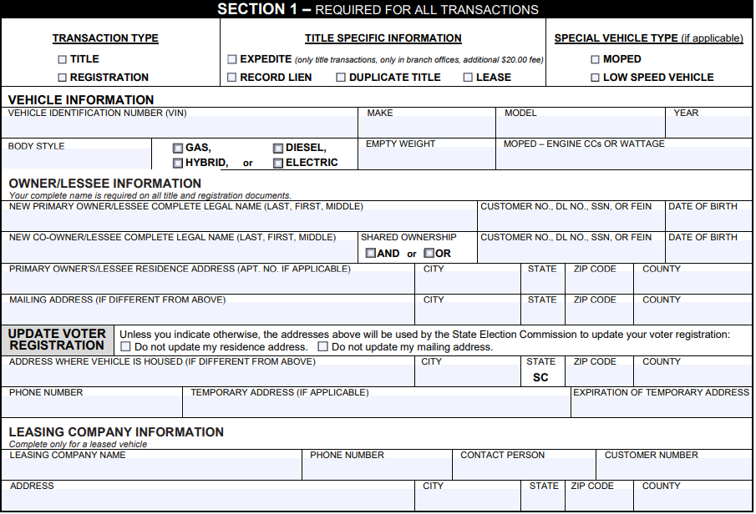
Title Application - Section 1
Enter each owner’s information from the documentation provided
If “AND” is chosen, then the listed owners will hold the title to the vehicle together. The signatures of both will be required for future title transactions.
The Housed Address may be listed if the vehicle will be at a different location than the primary owner’s residential address.
1
2
If the vehicle is leased, enter the leasing company’s information and it must match the company listed on the lease agreement.
If “OR” is chosen, this type of ownership is called a joint tenancy with right of survivorship. Either owner may sign for future transactions.
1
2

Slide 44
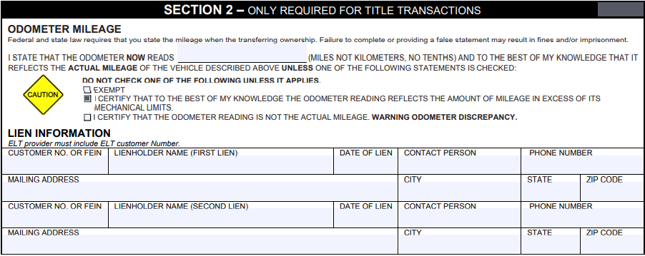
Title Application - Section 2
In the odometer mileage field, enter the current mileage at the time of titling and/or registration. The mileage should be the current mileage and not the mileage listed at the time of sale.
1
Complete this area only if there is a lien on the purchased vehicle. The information must match all supporting documents. If the lien holder is an ELT, list the ELT customer number provided by the lender.
1
Do not check one of the mileage options – “Exempt”, “Excess of Mechanical Limits” or “Not Actual Mileage” – unless it applies.
Mileage is required unless marked “Exempt”.

Slide 45
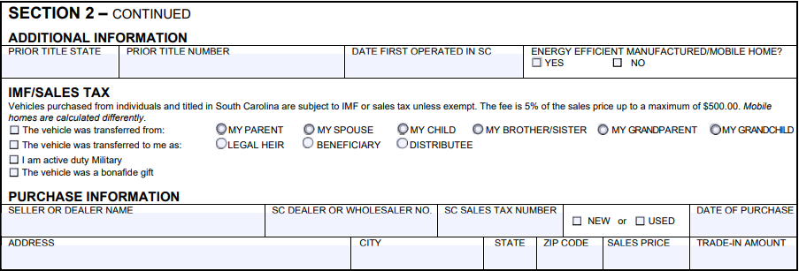
Title Application - Section 2 (cont.)
Only Required For Title Transactions
Dealers must indicate their Dealer Number, Sales Tax ID, the sales price(including fees), and trade-in amounts, along with the dealership’s address.

Slide 46
Title Application - Section 3
Only Required For Registration Transactions
1
2
1
If a plate is being transferred from one vehicle to the newly acquired vehicle, enter the plate number in the section provided.
2
If the vehicle is a truck or cargo van GVW is required.

Slide 47
Title Application - Section 4
Only Required For All Transactions
The owner(s) signature is required, or a signature supported by a power of attorney.
For joint ownership, remember that both signatures are required if “AND” is selected in “Section 2”.

Slide 48
Other Documentation

Slide 49
SCDMV Form 4034 – Affidavit for Repossessed Motor Vehicle
If a vehicle was previously repossessed, the title should be accompanied by Form 4034 completed by the repossessing lien holder.
The first assignment on the title should be completed by the lien holder to the acquiring dealer.
This process is used for SC titles and titles from out of state.

Slide 50
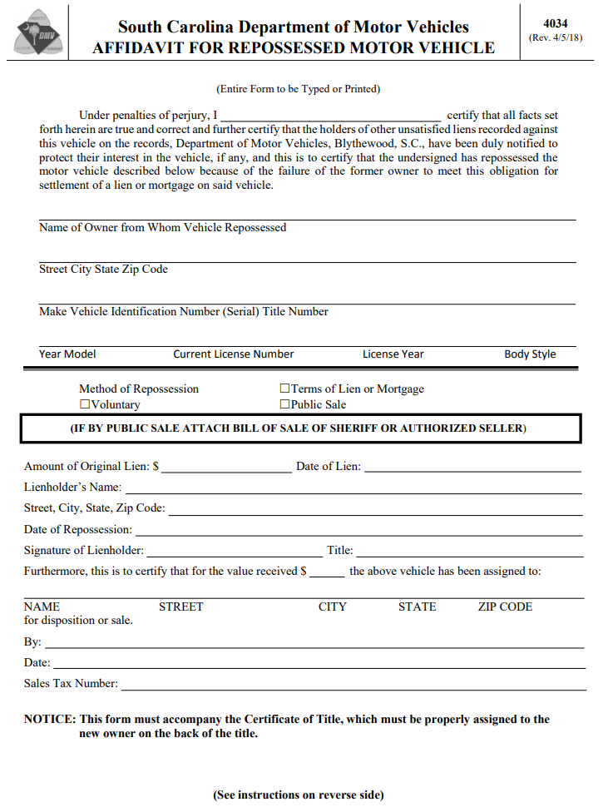
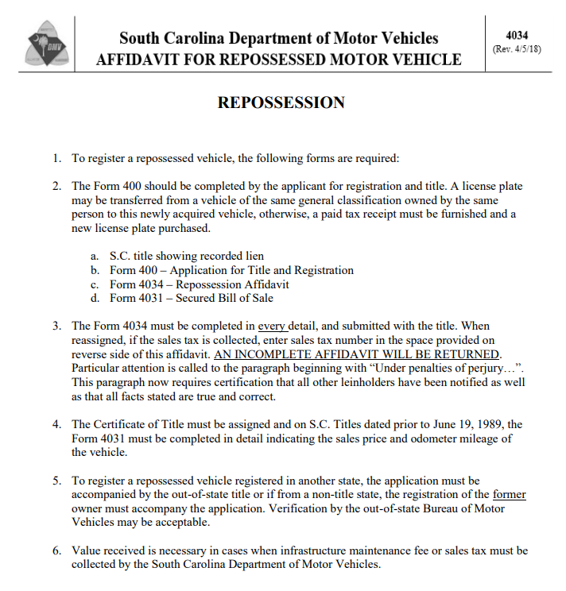

Slide 51
Magistrate’s Bills of Sale/Court Orders
Can not be used in chain bills of sale.
When awarded to a dealership, the dealership must title the vehicle before transferring
Individuals with magistrate’s bills of sale or court orders must title these vehicles in their name before trading in

Slide 52
Electronic Signatures
At this time, the DMV does not accept electronic signatures on title reassignments and odometer disclosure documents – i.e. MCO, Title, PTO, Form 5047, Odometer Disclosure.
They are acceptable on the Form 400

Slide 53
SC EVR&T Program
Provides immediate, remote title and/or registration of vehicles
Eliminates the need to wait in line for vehicle registrations
Provides better and more efficient DMV service remotely
Provides access to the most up-to-date information for your customers
Provides the ability to update customer data instantly
Reduces the dependency on the DMV customer service center offices

Slide 54
SC EVR&T Program
With EVR&T, everyone is a winner
Dealers and insurance agents save time and money
Customers get one-stop shopping without the wait for registration and title application processing
Customers can be served efficiently.

Slide 55
National Motor Vehicle Titling Information System (NMVTIS)
SCDMV Encourages NMVTIS checks prior to used vehicle sales
Prevents sale of vehicles that cannot be titled
Official Government Records
96% of Registered US Vehicles Reported
http://www.vehiclehistory.gov/nmvtis_vehiclehistory.html

Slide 56
Out of State Titles
For dealers that participate in EVR Program:
Use quick reference guide to entering title numbers
NMVTIS Suspense Issues:
State Discrepancy
Brand Discrepancy
Odometer Discrepancy
Junk Vehicles

Slide 57
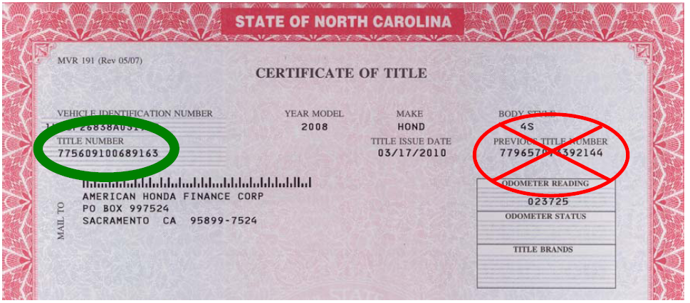
North Carolina & Georgia Titles
Dealers have been entering a lot of incorrect title numbers from North Carolina and Georgia titles. Users will often enter the previous title number listed instead of the current title number listed. Please be careful and enter the ENTIRE correct North Carolina or Georgia title number.

Slide 58
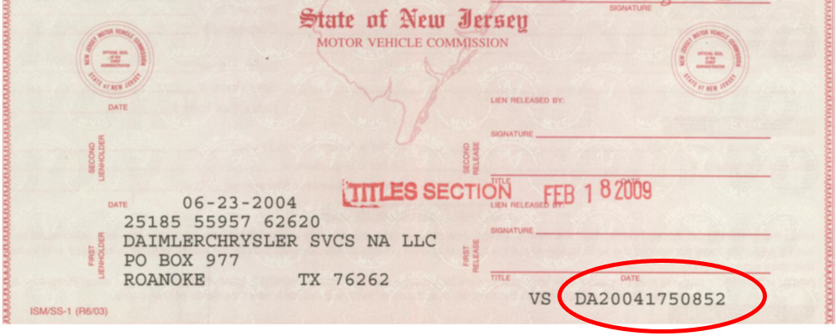
Identify title number for the state of NJ
Dealers often enter the incorrect title numbers from New Jersey
Users will often enter the document control number for the title number.
New Jersey title numbers (see circled below) includes two characters and the number to be used as the title number at the bottom right-hand corner of the document.

Slide 59
Identify and enter the title issuance date as the title number in for the states of CA, and NY
Because California and New York do not use a title number or a similar number either on the title document or in the title database, California and New York fill in the Title Number field with the title issue date. Place the title issue date in the title number field in the following format – 20060407 – using the data from the title as shown below.

Slide 60
Traceable Temporary License Plates
Senate bill 1083 required DMV to administer a program and regulate the process for issuing 45-day temporary plates for newly acquired vehicles.
Law enforcement must have the ability to obtain information via the current inquiry process. (Temporary Plate owner, vehicle data, plate expiration. This is required for all vehicle registered in SC.)
This law took effect November 11, 2019. Any customer that submits an application for a 45-day temporary plate will receive a traceable temporary license plate.
The 45-day temporary plate must be associated with the vehicle and new owner of the vehicle to be used for 45-days from the date of purchase.
Non-traceable 45-day temporary license plates are no longer issued.

Slide 61
Areas Impacted
Licensed Auto Dealers, SCADA, CIADA, EVR Providers
45-day temporary plates will be issued from Phoenix in branch offices for casual sales
45-day temporary plates will be issued via EVR process for dealer sales
45-day temporary plates will not be issued by county offices
45-day temporary plates will only be available to the buyer. Sellers will no longer be allowed to purchase 45-day temp plates for casual sales

Slide 62
YOUR NEXT STEPS as a dealer
Contact an SCDMV EVR Service Provider (see information on next slide)
You will submit the following to your selected EVR Service Provider
Completed SCDMV form EVR-3 (Electronic Vehicle Registration Titling Program Auto Dealer Application)
Complete the SCDMV Dealer Contract
The EVR Service Provider will forward the form EVR-3 and Contract to SCDMV. You are then responsible for signing up for the basic title and registration class with SCDMV. For more information, please visit our website at http://www.scdmvonline.com/Business-Customers/Dealers/Titling-Class-for-Auto-Dealers
Remember: When Completing the SCDMV Dealer Contract, please ensure that the Owner/principal information matches the listed owner/contact person associated with SCDMV Dealer License customer number.
Please ensure that all sections to be completed by SCDMV on contract and applications forms are left blank , this will help eliminate rejection applications

Slide 63
Current EVR Providers &
Association Contacts
Computerized Vehicle Registration: Patrick Murphy, CVR State & Inventory Operations Manager; Phone: 843-693-5010, Email: PMurphy@CVRConnect.com or Tony Tillis, Territory Manager for GA, NC, & SC: Phone: 404-655-5276, Email: TTillis@CVRConnect.com
Decision Dynamics, Inc.: Phone: 844-836-1621, Email: Sales@DDITechnology.com
Title Tec: Diane Zewalk, Area Sales Director; Phone: 919-909-7110, Email: Diane.Zewalk@titletec.com
South Carolina Automobile Dealers Association (SCADA): 803-252.-0205
Carolina Independent Automobile Dealers Association (CIADA): 800-432-4232 or 704-455-2117

Slide 64
TO Stay up-to-date on any law or policy changes for dealers
Please continue to visit our website at SCDMVonline.com
“Dealer Communications”
Evr Dealerships - (803) 896-5000, option 3
You can sign up for dealer title and registration classes by CONTACTING our Training DEPARTMENT at TRAINING@scdmv.net

Slide 65
Current EVR Dealers
Current EVR dealers when requesting customer numbers or have customer numbers to be combined please e-mail the following form(s)
EVR-1 (individual customer)
EVR-2 (business customer)
CM-002 (to combine multiple customer numbers)
To evr@scdmv.net. We are moving away from these forms being faxed.

Slide 66
Doing Business at SCDMV
Wednesday Morning Training – 8:30-9:30
3 Transactions per Day
Tuesday and Thursday
8:30 - 11:00
1:30 - 3:30
1 Transaction per Day
Monday and Friday
Drop Offs – Processed within 3-5 Business Days
Packets of 15
Any Monday - Friday
Any DMV
Wait Times Online

Slide 67
Mailing Paperwork to SCDMV
Mail all applications to:
SCDMV 10311 Wilson Boulevard Post Office Box 1498 Blythewood, SC 29016
Please use zip extension:
0024 for Title Only
0008 for Title and Registrations
0025 for EVR Transactions
Do Not Mail to Local Branch Office

Slide 68
Contact
Customers may contact SCDMV at:
(803) 896-5000 help@scdmvonline.com
For questions relating to IMF please e-mail cartaxes@scdmv.net
Please use our website address is www.scdmvonline.com
EVR Title Transaction Questions: vehicle.compliance@scdmv.net
Dealership questions:
EVR Dealerships – Please contact your service provider
All other questions:
Dealer Licensing – (803) 896-2611

Slide 69
training@scdmv.net

